Slide 1
Connected Device Studio Skill Transfer Workshop
Kevin Kao | Walker Lin | Andy Li
Microsoft IoT Innovation Center

Slide 2
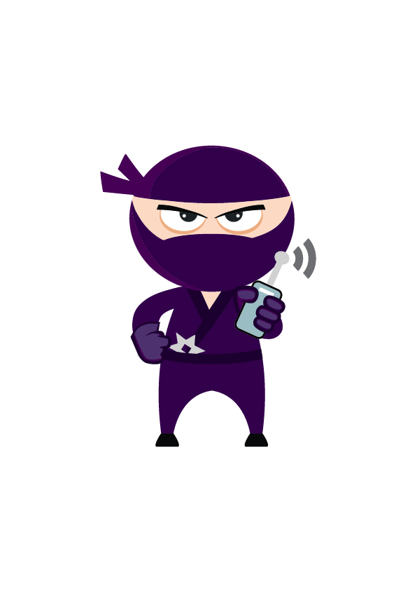
Content
Section 1 (4 hours)
Deploy Azure Services
Deploy DB and Data
Deploy API Service, Admin and SuperAdmin
Deploy Backend Tasks
First Company Onboarding
Remote Monitoring
Section 2 (4 ~6 hours)
DB Schema Overview
API Service (EF, Authentication and Class Model)
Admin & SuperAdmin (MVC and Call Flow)
Toolkit Device SDK & IoT Hub Receiver
Signal R & Message
Section 3 (4 hours)
Service Bus & OpsInfra, OpsAlarm, RoutineTask
Document DB
Service Fabric
Log & Operation and Trouble Shooting
Section 4 (4 hours)
How to Add New API
How to Add New Widget
How to Setup Staging Env

Slide 3
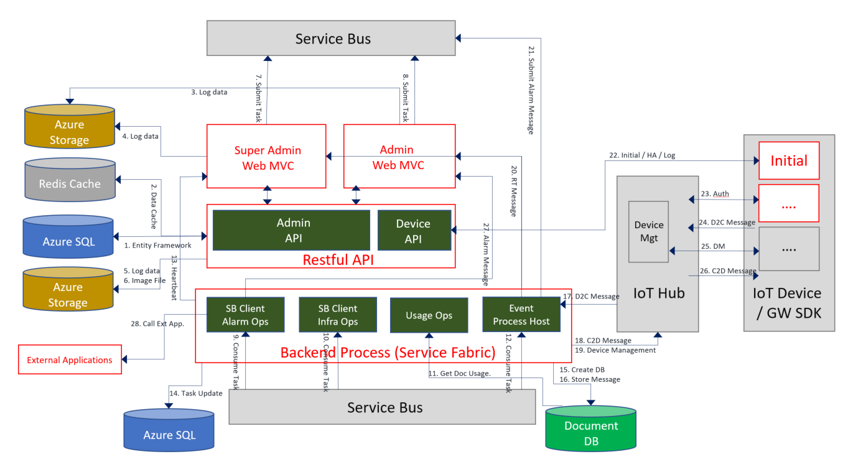
Architecture

Slide 4
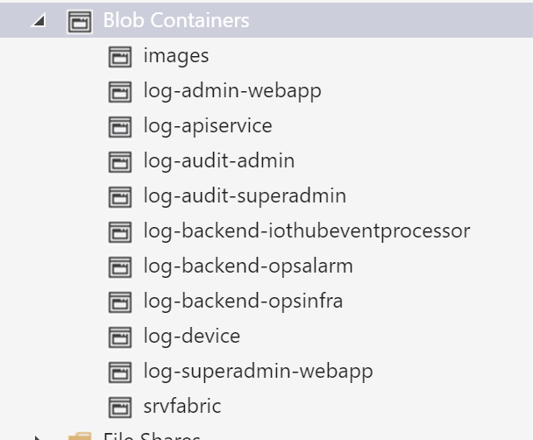


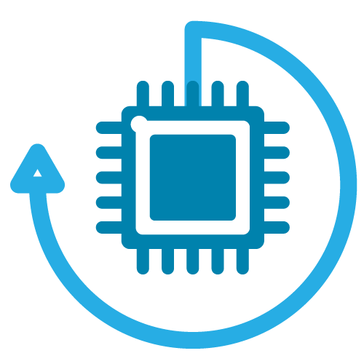
Log Architecture
Admin Web
IoT Hub Event Processor
Alarm Ops
Blob Storage
Super Admin
Store log in blob containers
Configuration defined: app.config or web.config
Log Level: Info, debug, waring, audit, error
Infra Ops
IoT Device
Routine Task
API Service
SG/HK

Slide 5
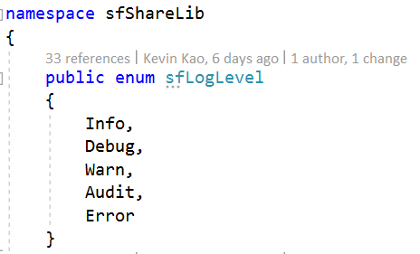
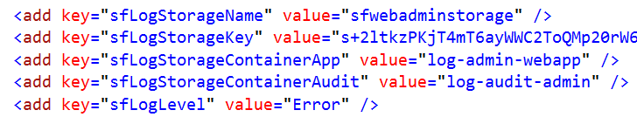
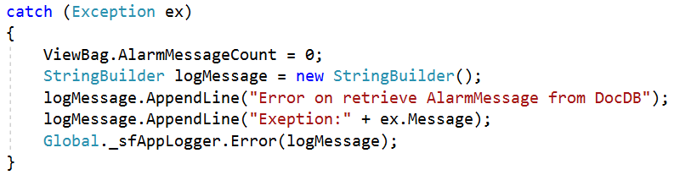
Log Target Definition
ShareLib/LogUtility.cs
Web.config
Global.asax
C# Code

Slide 6
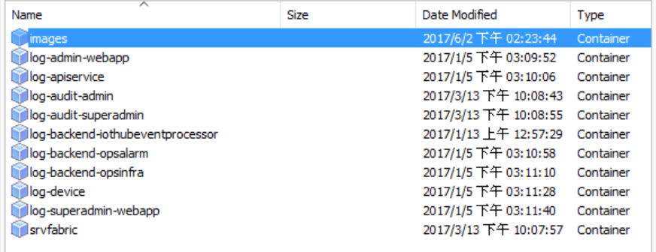
Log Container Structure
Azure Storage Service
Log-audit-admin and Log-audit-superadmin are for trace user login records.
Routine task store log at opsinfra container.
P.S. Below two folders are nothing with Log.
Folder(images) : Store company, factory, equipment image and phones.
Folder(srvfabric) : Store X.509 certificate of service fabric.

Slide 7
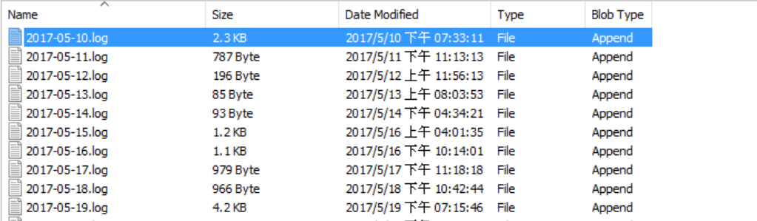
Log Files Structure
Files in Container
File Name: YYYY-MM-DD.log
But the time on content is UTC.
Log content

Slide 8
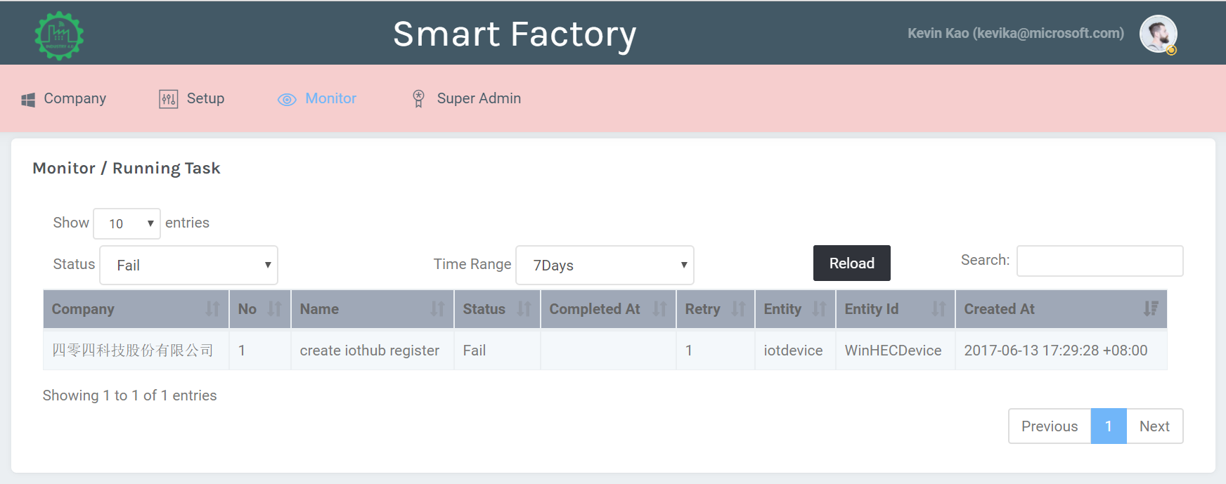
Task Execution Log
Status: Fail | Warning

Slide 9
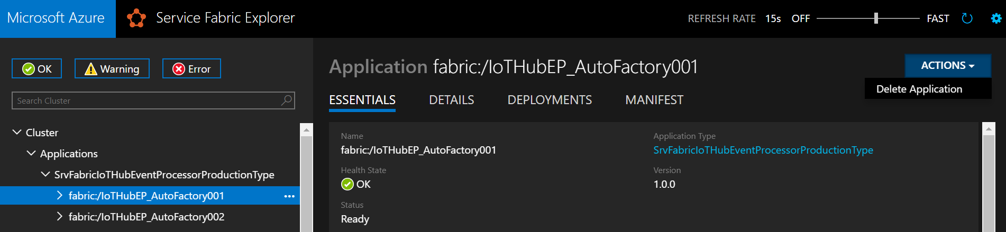
Shutdown IoT Hub Receiver Manually
IoT Hub Receiver will be launched when create a new IoT Hub alias.
IoT Hub Receiver will be removed when delete an IoT Hub alias.
You may want to manually shutdown one IoT Hub Receiver in below case:
Someone remove IoT Hub service directly (to avoid too many error in log)
Someone remove Storage service, which bind with IoT Hub directly (to avoid too many error in log)
You don’t want to receive message from this IoT Hub Receiver

Slide 10
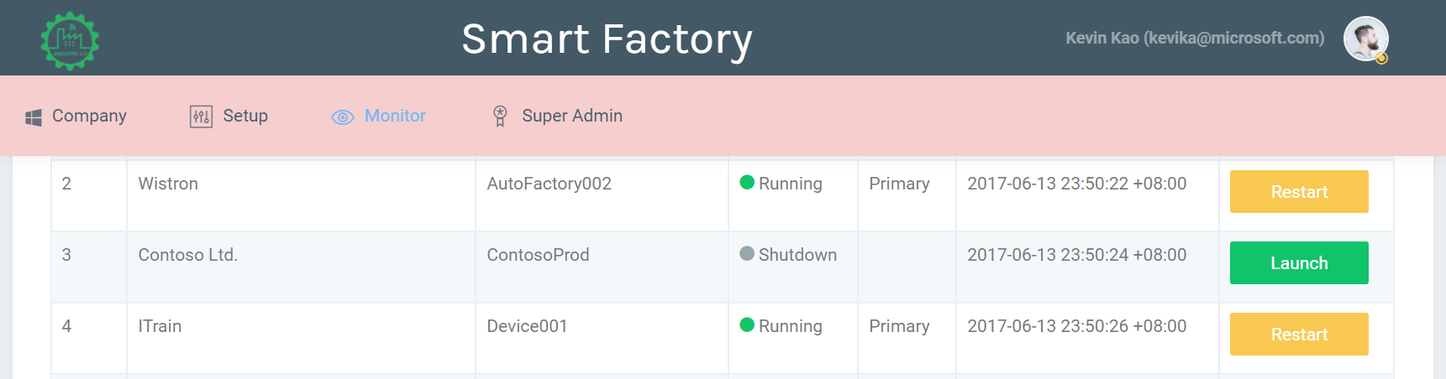
Launch IoT Hub Receiver Manually
For any reason, the IoT Hub Receiver be shutdown, you can launch it manually

Slide 11
Section 2 Log, Operation and Trouble Shooting End
Kevin Kao | Walker Lin | Andy Li
Microsoft IoT Innovation Center

